Slide 1
Business question and method: Did engagement and passenger bookings improve after the September 3 Dr. Greger announcement?
Email results: Click-rate chart showing approximately 126% higher engagement.
Booking results and limitations: One passenger before versus five afterward in equal 27-day windows; dates cannot prove attribution.

Slide 2
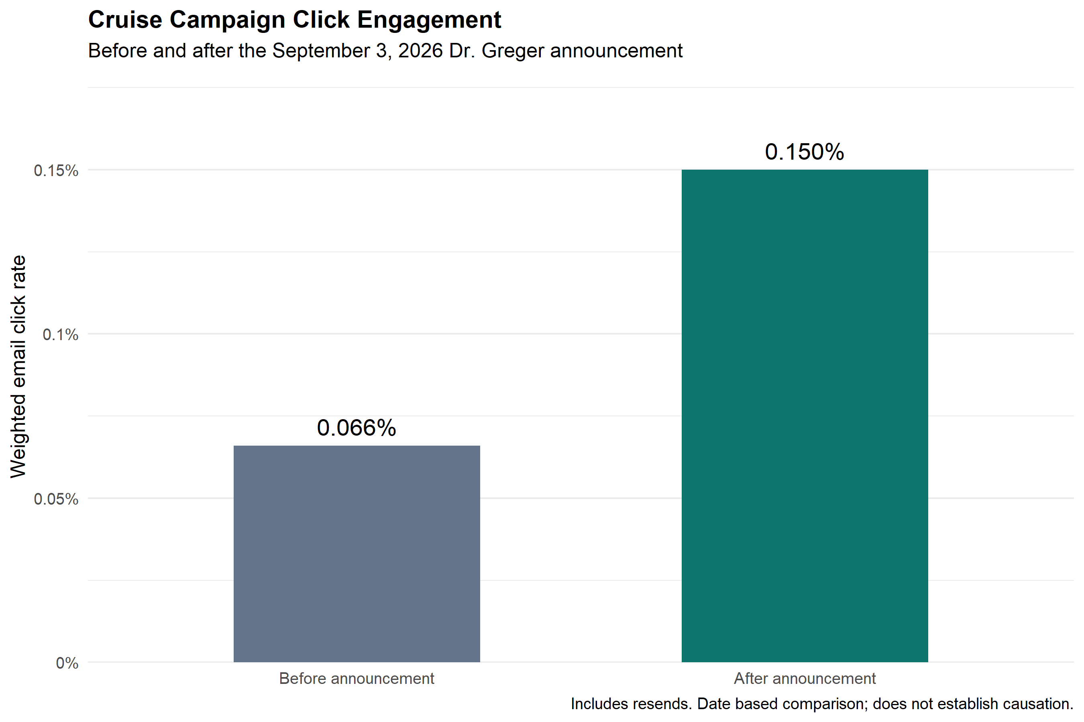

Slide 3


